Slide 1
MEAN Stack
A complete JavaScript technology stack
January 2016
Rajesh Kumar Jha
Module Lead UI
Notes:
Option - 1

Slide 2
CONTENTS
01
Introduction
MongoDB & DB Schema
Node.js and Express framework
Front-End with Angular JS
Conclusion
02
03
04
05

Slide 3
What to expect from this session?
Will get a high-level understanding of the main components that make up an app using the MEAN stack.
Will be able to put together the app described using the tools presented and have a feel for the "flow" of working with this stack and to write some JavaScript.
Will develop a simple blog post app with MEAN stack to get working experience on JavaScript end to end.
This is a beginner tutorial so there won't be deep technical dives.
If you get stuck, you can ask me for help.

Slide 4
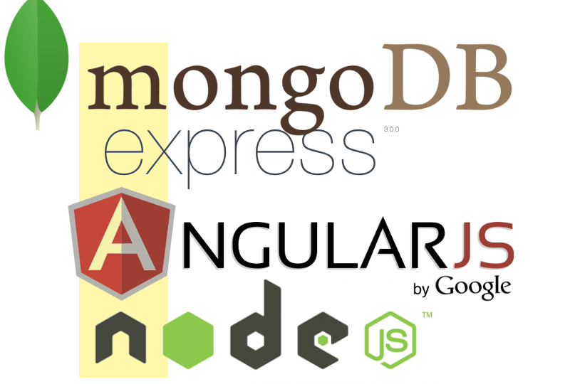
Mean is an acronym:
M = MongoDB, the most popular NOSQL operational database
E = Express.js, a lightweight web application framework
A = Angular.js, a robust framework for creating HTML5 and JavaScript rich web applications
N = Node.js, a server-side JavaScript interpreter

Slide 5
Same Lang Same Object, End-to-End
Mongo DB
Node JS
Angular JS
{
"_id" : 1,
"username" : “user1"
}
{
"_id" : 1,
"username" : “user1"
}
{
"_id" : 1,
"username" : “user1"
}

Slide 6
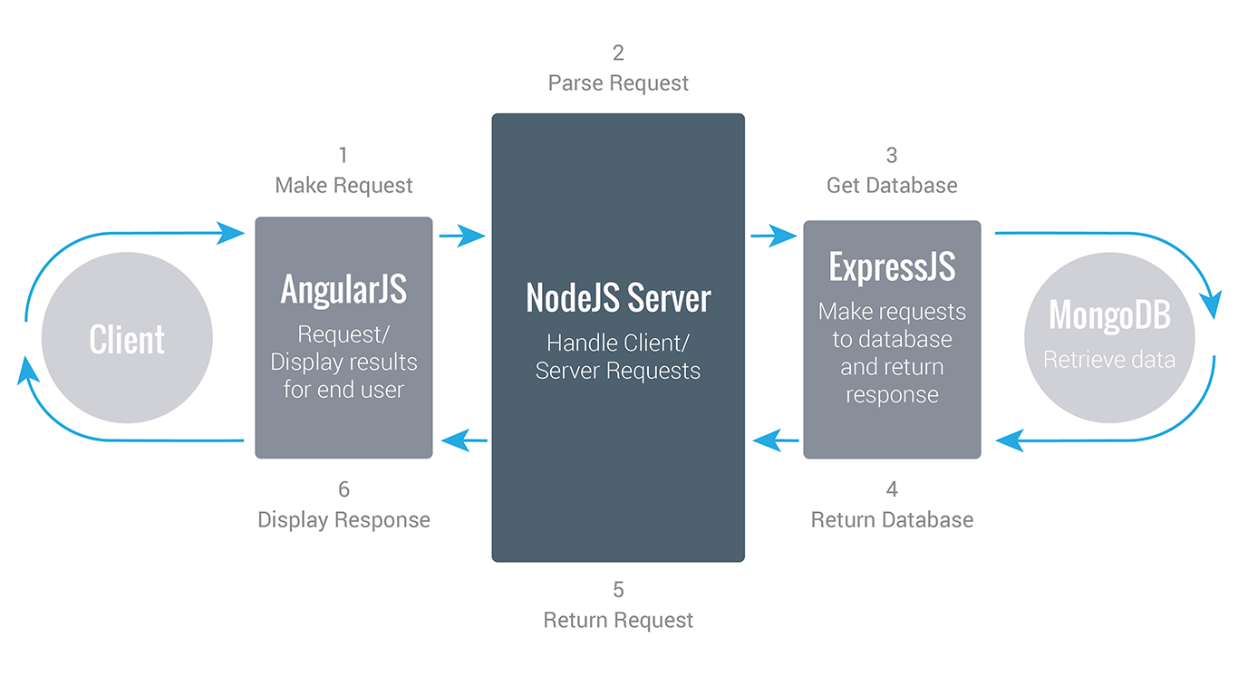
Mean Workflow:
Notes:
For internal use only

Slide 7

Blog app
A blog is a frequently updated online personal journal or diary
Features we are going to implement.
  Log In/Logout
  Signup
  Add Post
  Add Comment
25 years of bringing software to life and life to software
Notes:
For internal use only

Slide 8
MongoDB
A cross-platform document-oriented database.

Slide 9
What is MongoDB?
Mongo DB is an open-source document database that provides high performance, high availability, and automatic scaling.
MongoDb Characteristics:
  Schema Free
  Suitable for storing all kinds of data.
  Non –Relational Data
  Stores data as a JSON document.
  Horizontally scalable database
25 years of bringing software to life and life to software
Notes:
For internal use only

Slide 10
What is Document Database?
A record in Mongo DB is a document, which is a data structure composed of key-value pairs.
Mongo DB documents are similar to JSON objects.
The values of key may include other documents, arrays, and arrays of documents.
The advantages of using documents are:
Documents (i.e. objects) correspond to native data types in many programming languages.
Embedded documents and arrays reduce the need for expensive joins.
Dynamic schema supports fluent polymorphism.
25 years of bringing software to life and life to software
Notes:
For internal use only

Slide 11
Key Features of MongoDB
High Performance
  MongoDB provides high-performance data persistence through:
    Support for embedded data models reduces I/O activity on the database system.
    Indexes support faster queries and can include keys from embedded documents and arrays.
High Availability
  To provide high availability, MongoDB’s replication facility, called replica sets, provide:
    - automatic failover.
    - data redundancy.
    A replica set is a group of MongoDB servers that maintain the same data set, providing redundancy and increasing data availability.
25 years of bringing software to life and life to software
Notes:
For internal use only

Slide 12
Key Features of MongoDB
Automatic Scaling
  MongoDB provides horizontal scaling as part of its core functionality.
  In a database horizontal-scaling is often based on partitioning of the data i.e. each node contains only part of the data , in vertical-scaling the data resides on a single node and scaling is done through multi-core i.e. spreading the load between the CPU and RAM resources of that machine.
  Automatic sharding distributes data across a cluster of machines.
  Replica sets can provide eventually consistent reads for low-latency high throughput deployments.
25 years of bringing software to life and life to software
Notes:
For internal use only

Slide 13
Installation
Download MongoDB from http://www.mongodb.org/downloads.
Run the installer, A set of screens will appear to guide you through the installation process. After installation following set of binary component available in installation directory.
Server | mongod.exe
Router | mongos.exe
Client | mongo.exe
Monitoring Tools | mongostat.exe, mongotop.exe
Import-export Tools | mongodump.exe, mongorestore.exe, mongoexport.exe, mongoimport.exe
Miscellaneous Tools | bsondump.exe, mongofiles.exe, mongooplog.exe, mongoperf.exe
25 years of bringing software to life and life to software
Notes:
For internal use only

Slide 14
Installation
Set up the MongoDB environment.
  MongoDB requires a data directory to store all data. MongoDB’s default data directory path is \data\db. You can specify an alternate path for data files using the --dbpath option to mongod.exe, for example:
  > C:\mongodb\bin\mongod.exe --dbpath d:\test\mongodb\data
  If your path includes spaces, enclose the entire path in double quotes, for example:
  > C:\mongodb\bin\mongod.exe --dbpath "d:\test\mongo db data“
Start MongoDB
> C:\mongodb\bin\mongod.exe
Connect to MongoDB
> C:\mongodb\bin\mongo.exe
25 years of bringing software to life and life to software
Notes:
For internal use only

Slide 15
Installation
Create a Windows Service for MongoDB
  You can set up the MongoDB server as a Windows Service that starts automatically at boot time.
  Open a command prompt as administrator.
  Create directories for your database and log files:
  > mkdir c:\data\db
  > mkdir c:\data\log
  Create a configuration file
  The file must set systemLog.path. Include additional configuration options as appropriate.
  For example, create a file at “C:\mongodb\mongod.cfg” that specifies both systemLog.path and storage.dbPath:
25 years of bringing software to life and life to software
Notes:
For internal use only

Slide 16
Installation
systemLog:
destination: file
path: c:\data\log\mongod.log
storage:
dbPath: c:\data\db
Create the MongoDB service
> sc.exe create MongoDB binPath= "C:\mongodb\bin\mongod.exe --service
--config=\"C:\mongodb\mongod.cfg\"" DisplayName= "MongoDB" start= "auto"
Note: sc.exe requires a space between “=” and the configuration values (eg “binPath= ”), and a “\” to escape double quotes.
25 years of bringing software to life and life to software
Notes:
For internal use only

Slide 17
Server Coding with
Node.js and Express Framework

Slide 18
What is node.js?
Node.js is a platform built on Chrome's V8 JavaScript runtime for easily building fast, scalable network applications.
Node.js uses an event-driven, non-blocking I/O model that makes it lightweight and efficient, perfect for data intensive real-time applications that run across distributed devices.
Single Threaded
Event Driven
Instead of threads Node uses an event loop with a stack
25 years of bringing software to life and life to software
Notes:
For internal use only

Slide 19
What is NPM?
Node.js applications are built using a lot of library modules.
You define a package.json file describing your application and all of it’s library dependencies
You use the Node.js Package Manager to install a copy of those libraries in a subdirectory of your application (node_modules/) instead of a system directly (like /usr/lib) to avoid the problem of different apps needing different and conflicting library versions.
Run “npm install” and it will create the node_modules/ with all of your required libraries
25 years of bringing software to life and life to software
Notes:
For internal use only

Slide 20
Node installation
Download Node.js from https://nodejs.org/en/download/
Run the installer, A set of screens will appear to guide you through the installation process.
To check open cmd and type
> node –v
it will return installed node.js version.
25 years of bringing software to life and life to software
Notes:
For internal use only

Slide 21
What is Express?
Express is a minimal and flexible Node.js web application
framework that provides a robust set of features for web and
mobile applications.
It is used for easier creation of web applications and services
Express.js simplifies development and makes it easier to write secure, modular and fast applications
25 years of bringing software to life and life to software
Notes:
For internal use only

Slide 22
Express Setup
//Create directory meanstack-blogapp for application
> mkdir meanstack-blog
//Locate to directory
> cd meanstack-blog
//Install express-generator globally
> npm install express-generator –g
//Create express application with handlebar template at current location
> express --hbs . //generate app in current directory
> npm install //Install dependencies
//Run app
> npm start
//Then load http://localhost:3000/ in your browser to access the app.
25 years of bringing software to life and life to software
Notes:
For internal use only

Slide 23
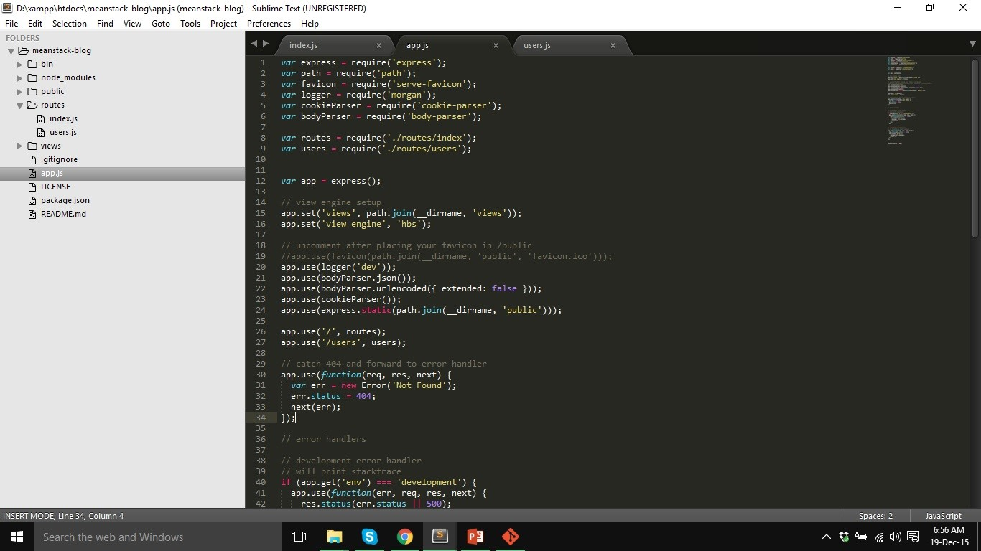
App Structure
25 years of bringing software to life and life to software
Notes:
For internal use only

Slide 24
MongoDB connection
//Install MongoDb driver
> npm install mongodb –save
//Update app.js to import mongodb module and initialize MongoClient
// Mongo Db Connection
var MongoClient = require('mongodb').MongoClient;
// Connection URL
var url = 'mongodb://localhost:27017/blog';
25 years of bringing software to life and life to software
Notes:
For internal use only

Slide 25
MongoDB connection
// Make our db accessible to our router app.use(function(req, res, next){
// Use connect method to connect to the Server MongoClient.connect(url, function(err, db) { if(err){
console.log(null, err); }
else{
console.log("Connected to server");
req.db = db;
}
next();
});
});
25 years of bringing software to life and life to software
Notes:
For internal use only

Slide 26
MongoDB connection
The app.use statements are establishing middleware for Express.
The short, simple explanation is: they're providing custom functions that the rest of your app can make use of.
It runs before our route definitions, so that they can make use of it.
By adding this function to app.use, we're adding db object to every HTTP request (ie: "req") our app makes
25 years of bringing software to life and life to software
Notes:
For internal use only

Slide 27
Blog - API Development
User API
URL | METHOD | PARAMS | RESPONSE
/user/register | POST | { "username" : "", "password" : "", "emai":"" } | { "status":"", "message":"" }
/user/login | POST | { username : "", password : "" } | { "status":"", "data":{ "user_id":"", "email_id":""} }
25 years of bringing software to life and life to software
Notes:
For internal use only

Slide 28
Blog - API Development
BLOG POST API
URL | METHOD | PARAMS/DATA | REAPONSE
/blog/post/list | GET | {} | { _id":"", "title":"", "description":"", "user_id":"", "comments":[{ "comment":"", "user_id":"}] }
/blog/post/add | POST | {"title":"", "description":"", "user_id":"", "comments":[{ "comment":"", "user_id":"}]} | { "status":"", "message":"" }
/blog/post/comment/add | POST | {"post_id":"", "user_id":"", "comment" : ""} | { "status":"", "message":"" }
25 years of bringing software to life and life to software
Notes:
For internal use only

Slide 29
Blog - API Development
var express = require('express'); var router = express.Router(); Router.[HTTP METHOD](‘relative url’, handler(req, res, next)); Example : router.post('/user/register', function(req, res, next) { }); router.get('/post/list', function(req, res, next) { });
req.body : Contains key-value pairs of data submitted in the request body.
req.params : An object containing properties mapped to the named route “parameters”.
req.query : An object containing a property for each query string parameter in the route. If there is no query string, it is the empty object, {}.
25 years of bringing software to life and life to software
Notes:
For internal use only

Slide 30
Frontend code with Angular JS

Slide 31
Sample title style (Arial - 28pt - Bold)
Angular JS is an open source web-application framework, specially designed for single-page web application well maintained by Google.
Open source
Framework not a library
Uses jQuery’s jQlite
Contains everything you need for SPA
Broken into components Controllers, view, models, services, etc
MVC/MVVM Framework
Two Way Data binding
Enables test friendly code
25 years of bringing software to life and life to software
Notes:
For internal use only

Slide 32
Angular Components
Module : A module is a collection of services, directives, controllers, filters, and configuration information.
Scope : A Scope is an object that refers to the application model. It is an execution context for expressions. Scopes are arranged in hierarchical structure which mimic the DOM structure of the application. Scopes can watch expressions and propagate events.
Controller : A Controller is a JavaScript constructor function that operates the Angular Scope. When a Controller is attached to the DOM via the ng-controller directive, Angular will instantiate a new Controller object, using the specified Controller's constructor function. A new child scope will be created and made available as an injectable parameter to the Controller's constructor function as $scope. own filter.
25 years of bringing software to life and life to software
Notes:
For internal use only

Slide 33
Angular js -Angular Components
Directives : Directives are markers on a DOM element which attach a special behavior to it. Examples of directives are the interpolation directive ( {{ }} ), the ng-repeat directive and ng-if directive.
Filter : A filter formats the value of an expression for display to the user. They can be used in view templates, controllers or services and it is easy to define your own filter.
25 years of bringing software to life and life to software
Notes:
For internal use only

Slide 34
Frontend development – Code Setup
Create client directory in main application
> mkdir client
Bower
  A package manager for the web
  Install bower globally :
  > npm install bower -g
Bootstrap
  Bootstrap is the most popular HTML, CSS, and JS framework for developing responsive, mobile first projects on the web.
> bower install bootstrap
25 years of bringing software to life and life to software
Notes:
For internal use only

Slide 35
Frontend development – Code Setup
Angular
  AngularJS is a structural framework for dynamic web apps.
> bower install angular
> bower install angular-route
25 years of bringing software to life and life to software
Notes:
For internal use only

Slide 36
Frontend development – USER
Create file app.js in path client/js/.
Create module BlogAPP using angular module with ngRoute as dependency for route control.
Create UserService with login and signup method to call corresponding API.
Generate config add following functionality using controller and $rootProvider.
25 years of bringing software to life and life to software
Notes:
For internal use only

Slide 37
Frontend development – USER
Below are the functionality need to develop
Route | Controller | View
/ | MainController | views/home.html
/user/signup | SignupController | views/register.html
/user/login | LoginController | views/login.html
/user/logout | LogoutController | NA
25 years of bringing software to life and life to software
Notes:
For internal use only

Slide 38
Frontend development – Blog POST
Create PostService with following method to call corresponding API.
  list: to get all posts
  byId: to get post by post id
  add: to add post
  comment : to add comment
Update config to add following functionality.
Route | Controller | View
/post/id/:id | SignupController | views/register.html
/post/add | LoginController | views/login.html
25 years of bringing software to life and life to software
Notes:
For internal use only

Slide 39
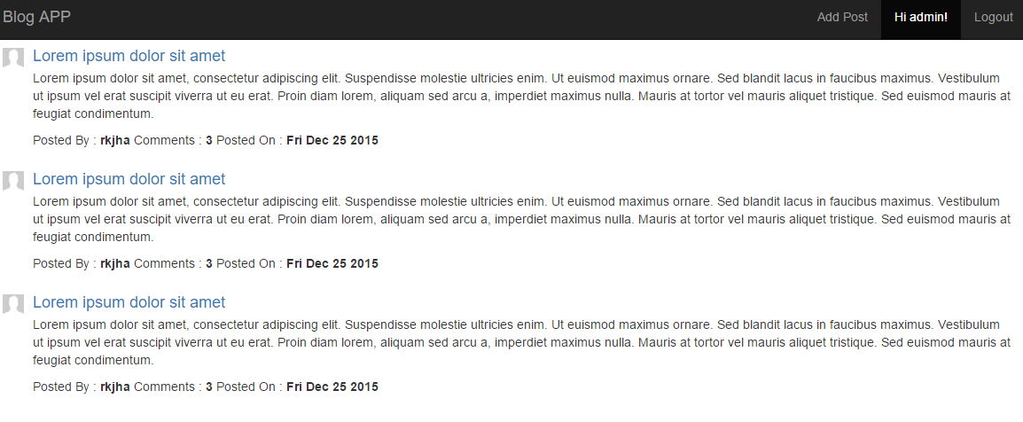
Final Output – Home Page
25 years of bringing software to life and life to software
Notes:
For internal use only

Slide 40
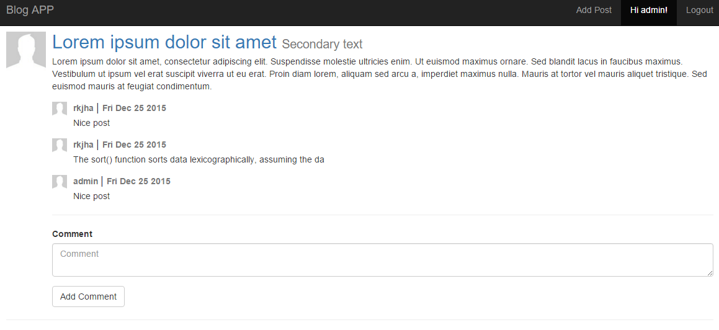
Final Output – Blog Detail Page
25 years of bringing software to life and life to software
Notes:
For internal use only

Slide 41
Contact Us
Name
###-###-####
email
Persistent Systems Inc.
2055 Laurelwood Road, Suite 210
Santa Clara, CA 95054
www.persistent.com

